Slide 1

Iso-surface Ambien Occlusion
Final Projection - ESC 277 (Winter 2019)
^{By: Ahmed Mahmoud}

Slide 2
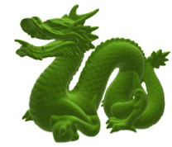
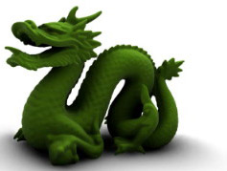
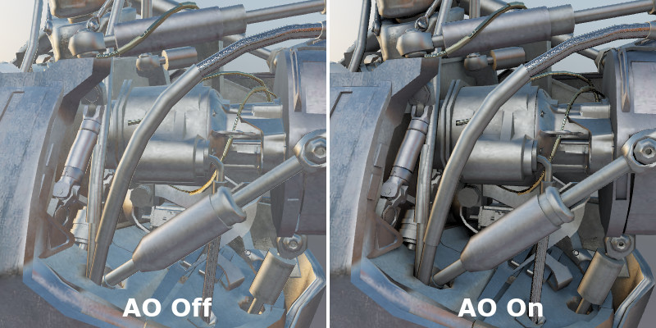
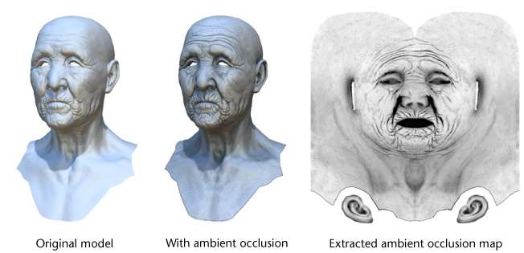
Definition
Ambient Occlusion
For a given point, it is the amount of light, from everywhere in the upper hemisphere center at the point, that does not arrive to that point
AO Off AO On
AO Off AO On
https://www.pluralsight.com/blog/film-games/understanding-ambient-occlusion
https://www.geforce.com/whats-new/guides/ambient-occlusion#1
Notes:
We need to have couple of definitions in order to be able to state our problem definition. The first is what is the ambient occlusion and it is the amount of light that should not be arriving to a given point because it is being occluded by other objects in the scene. Notice that our definition does not have anything to do with the view direction or the light direction. Thus, we can compute it once offline and use it many times for real-time application. It gives stunning effects as you can see here.

Slide 3
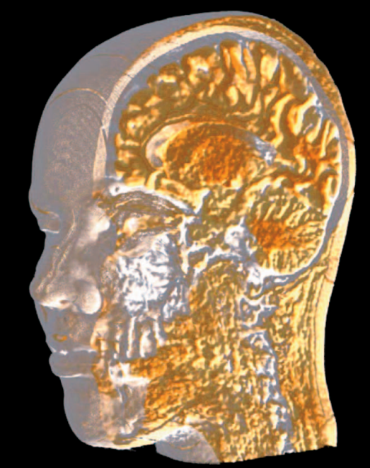
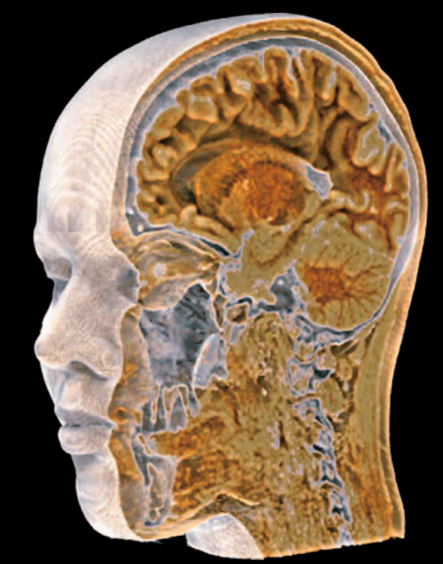
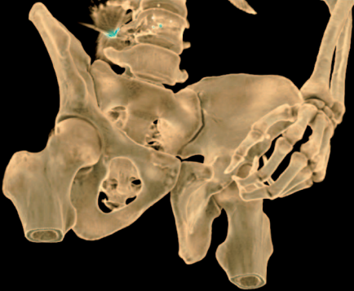
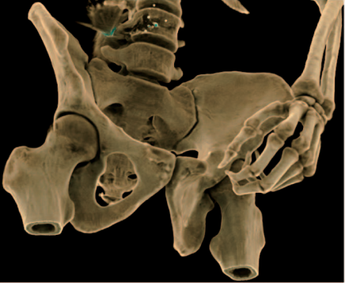
Definition
Ambient Occlusion
Used to give more realism
AO Off AO On
AO Off AO On
Hernell, Frida, Patric Ljung, and Anders Ynnerman. "Local ambient occlusion in direct volume rendering." IEEE Transactions on Visualization and Computer Graphics 16, no. 4 (2010): 548-559.
Notes:
Ambient occlusion is used to give the scenes more realism. It can be used with volume rendering also for the same reason. I have faced similar problem with diffuse illumination in the firs homework similar to the figure on the left and had to use some hack for every model in order to tune dune the lighting or the brightness. But ambient occlusion gives more efficient solution that works with any model or scene.

Slide 4
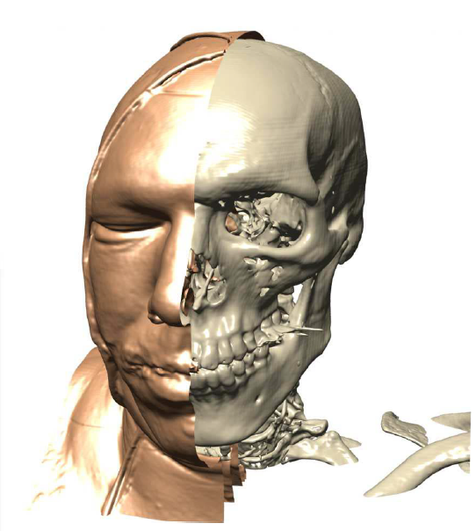
Definition
Iso-surface
Surface that represents a constant value of a given function aka level-set of 3D function.
Martin, Tobias, Elaine Cohen, and Robert M. Kirby. "Direct isosurface visualization of hex-based high-order geometry and attribute representations." IEEE transactions on visualization and computer graphics 18, no. 5 (2012): 753-766.
Notes:
The second definition is the iso-surface which is, for a volume data, is the surface that defines a constant-value function. Iso-surface visualization is used form when the user want to focus on a single value for the give function like here. The user maybe interested in viewing only the skull or the outer flesh without doing the whole volume rendering.

Slide 5
Problem Definition
Ambient Occlusion
+
Iso-surface
Notes:
So, my project is about how to apply ambient occlusion to give iso-surface visualization more realism. I am using here a new very simple technique to compute the ambient occlusion and it is based on a very efficient data-structure that is being used to represent the volume data as sparse grid implemented in openvdb. We will go over all of these terms

Slide 6
Problem Definition
Applications:
Dynamic volume data
https://insydium.ltd/
https://docs.chaosgroup.com
Notes:
One application that I think will benefit from this is for dynamic scene like these. So for these scenarios, you can separate the process into two steps; first do some computation to solve some physics equation about the how the smoke or fire in the next frame should look like (its shape), second do some computation to illuminate the given shape. For both the smoke and fire, they are represented on a gird as volume data (there is some volume inside the smoke). We are not going to worry about how the smoke or fire took their shapes i.e., the first step. All we care about is that they are volume data and we want to illuminate its surface. Since we found that ambient occlusion can give realist appearance, then we are going to use it. I have to mention that similar realist effects can be compute using ray-tracing but this could be expensive specially that you need to bounce the rays multiple time to get the realistic affect you want.

Slide 7
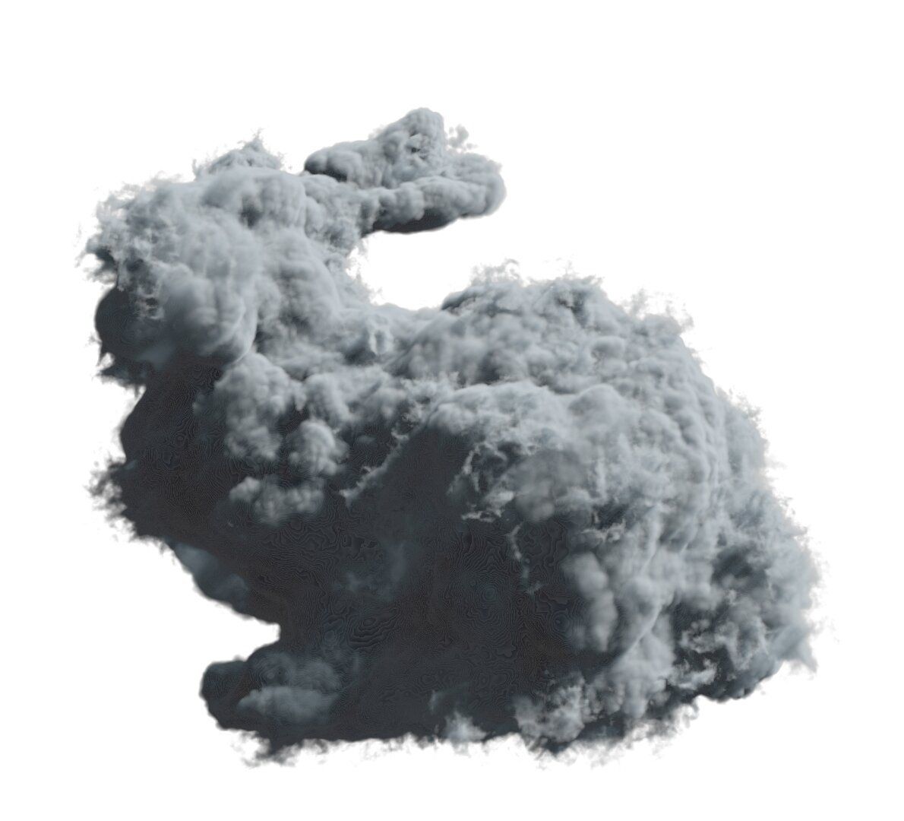
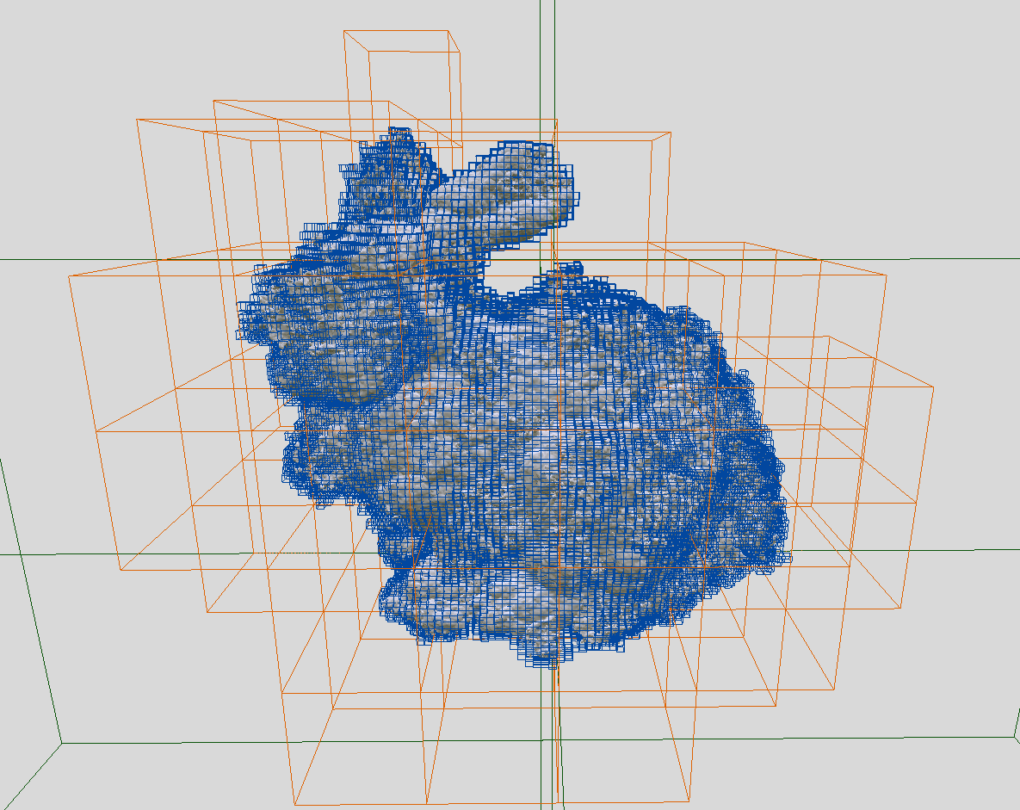
Sparse Grid
Data (density)
Sparse Grid Representation
Notes:
When you think about, we actually do not need a dense grid to represent our data. We only need “sparse grid” where we have voxels (little boxes) with the interesting data. The rest of the volume should be empty to save memory and computation.

Slide 8

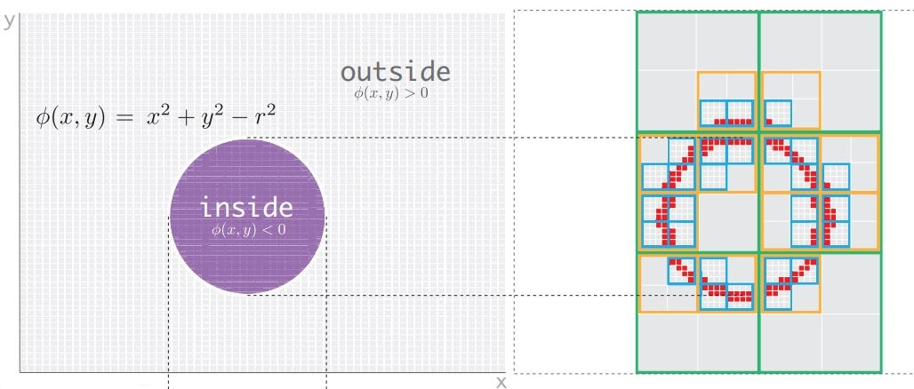
OpenVDB
Distance Field
Museth, Ken. "VDB: High-resolution sparse volumes with dynamic topology." ACM Transactions on Graphics (TOG) 32, no. 3 (2013): 27.
Notes:
The sparse grid representation I am using is baked in OpenVDB library developed by DreamWorks. This library has been used in many animation movies to do their simulation work and for that it won the Academy Award in 2015. It is a hierarchy of nodes where you only store the valuable data at the leaf nodes. So, for this circle, I only want to represent the circle (I don’t care about the inside nor the outside volume) which represent the level-set of this circle equation. The leaf nodes are the red voxels where you store their data. For this case, the red voxel will store zero. The other nodes (the light and dark gray nodes) are just internal nodes that are there to facilitate the traversal of the tree.

Slide 9
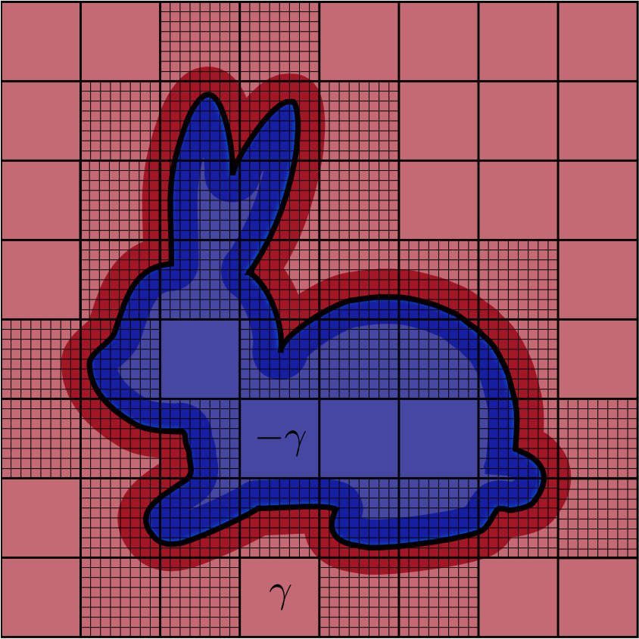
OpenVDB – Narrow Band
Narrow-band
Iso-surface
https://nexus.aswf.io/content/repositories/releases/io/aswf/openvdb/openvdb_introduction_2015/1.0.0/openvdb_introduction_2015-1.0.0.pdf
Notes:
So, now we can represent the iso-surface using grid of voxels. But often times, when we do the computation we need also the information from the neighboring cells. For example, in computing the gradient of scalar function using finite difference, you need to look for the left, right and up, down of the cell. This will lead us to not just represent the the iso-surface but also the a narrow-band around the iso-surface. Any voxel that happen to be inside be present inside this narrow band, we will store its value as well. For example, in this image, the red and blue represent sign distance; inside is –ve and outside is +ve. Every dark red/blue voxel store their value. Now, what you get is efficient representation of everything you can get from the a dense grid. This representation is very efficient for surface-tracking applications like the fire or smoke where the application is about tracking a moving surface.

Slide 10
Ambient Occlusion Intuition
Normal = Gradient
1) compute normal for every voxel “crosses” the iso-surface
Notes:
So, now we know what is narrow-band representation is, and we know what is ambient occlusion is. The question is how can we approximate ambient occlusion i.e., how for every point on the iso-surface can we figure out the number of other surfaces that occludes this point. My idea very simple to do this. It starts with iterating over all voxels that contain the iso-surface. For this image, the value of the iso-surface is zero. We can then easily compute the normal which is the gradient which can be computing via interpolation since we have the neighbor voxels value.

Slide 11
Ambient Occlusion Intuition
Actual = 1
Query = 1
2) Walk one step along the normal and query the voxel value
Notes:
Then we can normalize the normal vector and walk along it one step along this normal. Now I should expect that the distance I have walked is 1. Since we are storing the distance field inside our narrow band, I can query and ask the data structure about the value/distance of the voxel I have landed one. If it is the same as what I expect then I am good. I can walk one more step

Slide 12
Ambient Occlusion Intuition
Actual = 2
Query = 2
3) Keep repeating 2 until Query != Actual
Notes:
I do the same thing again. Now I walked two steps so I should expect the value of voxel I have landed on to be two.

Slide 13
Ambient Occlusion Intuition
Actual = 3
Query != 3
4) If Actual != Query, then increase the Ambient Occlusion factor the starting point by one
Notes:
I will walk one more step. However, after three steps, I should expect the value of the voxel to be 3 but I will not get 3. I will get maybe 2 because there is another surface that is closer to the query point which means there is a surface that occludes the point I have start from.

Slide 14
Ambient Occlusion Algo Sketch
Summary:
- For every voxel on the iso-surface do:
0) Initialize Ambient Occlusion factor by zero
1) Compute the voxel normal
2) Walk along the normal n steps
For every step i do:
Query the distance of the landing voxel →d_{i}
If abs(abs(d_{i}) – i) < ϵ
increment Ambient Occlusion factor by on
- Convert the voxel into mesh e.g., using marching cubes
- Color mesh vertices using Phong Model and multiply the color by (1- Ambient Occlusion factor) of the voxel containing the mesh vertex
Notes:
Here is a sketch for the algorithm. For every voxel on the iso-surface, we wan to compute its AO factor. So, we first intiailize it with zero, compute the voxel normal, walk along the n steps. For every step, query the distance of the landing voxel d_{i}, if there is a big difference between d_{i} and the expect value of the distance which is the number of the step (since we walk one step at a time), then we increment the AO factor. We do this for all the voxels on the iso-surface. Next the iso-surface is converted to mesh to visualize it. Marching cubes is used for this purpose. Each mesh vertex can be color any local illumination models e.g., Phong model. Finally, we multiply the color by 1-AO factor

Slide 15
Acknowledgment:
Original idea is from Serban Porumbescu; postdoc in our lab

Slide 16
Extra Slides
Summary:
- For every voxel on the iso-surface do:
0) Initialize Ambient Occlusion factor by zero
1) Compute the voxel normal
2) Walk along the normal n steps
For every step i do:
Query the distance of the landing voxel →d_{i}
If abs(abs(d_{i}) – i) < ϵ
increment Ambient Occlusion factor by on
- Convert the voxel into mesh e.g., using marching cubes
- Color mesh vertices using Phong Model and multiply the color by (1- Ambient Occlusion factor) of the voxel containing the mesh vertex
maybe need to incorporate (1/distance^2)
Notes:
Couple of things I am not sure about. First how to increment the AO factor. Maybe I should use (1/distance^2) since the impact of far away surface should be less than the impact of very close surface.

Slide 17
Extra Slides
Summary:
- For every voxel on the iso-surface do:
0) Initialize Ambient Occlusion factor by zero
1) Compute the voxel normal
2) Walk along the normal n steps
For every step i do:
Query the distance of the landing voxel →d_{i}
If abs(abs(d_{i}) – i) < ϵ
increment Ambient Occlusion factor by on
??
Notes:
Another technical issue is what if you step out of the narrow band but still you want to walk further. Like at this example, we should not stop because if walk further, we will hit the bunny ear and the AO factor of the this voxel will not be zero. Here we can employ coarser gird where the leaf node are much larger and thus has lower resolution approximation of the distance field. Doing this in this example, once I step out of the narrow-band, I can query the coarse grid and will get some value that is not very accurate but it is okay because I am already far away from the surface

